Slide 1
Can Social Media help understand the political (election) agenda of the candidates to the general masses ? A study using Twitter for Americal Election 2020
Bishwaraj Bhattarai

Slide 2
Abstract
This study aims to analyze twitter data (tweets) of the major candidates of the Americal Presidential Election 2020, to study if social media feed can be used to understand the major talking points/election agenda of the candidates. The twitter data is used to create Word-Clouds to see which topics are focused. Results indicate that it is difficult to understand the priorities/agenda, at least in advance leading up to the election. While similar analysis later, in the days leading up to the election, might suggest a more congruent understanding of the candidates’ election agenda/priorities, much of the tweets at early stage seem spontaneous reactions and thoughts rather than thought-out plans or strategies.

Slide 3
Motivation
Social media is increasingly seen as the primary medium of communication, including the transfer of news, and political agenda to the general public. Major news or announcements increasingly break through social media, which is leading the public to believe that all that appears on social media is serious and factual. The objective of this study is to explore if the social media (twitter) can be or rather has been, used as a medium to have serious and critical communication among political figures – election candidates, especially for conveying their priorities and election agendas. This can be useful for the general public in assessing how much faith one can put on the social media feed to form their political understanding.

Slide 4
Dataset(s)
This study uses publicly available tweets from 4 major candidates in the Amecial Presidential Election-2020. 3 candiates from the Democratic Party – Bernie Sanders - @BernieSanders, Elizabeth Warren - @ewarren, and Joe Biden - @JoeBiden, along with the sitting president – Donald Trump - @realDonaldTrump ’s tweets have been used. Most recent (as of December 15, 2000-GMT+5:45) 3200 tweets (twitter limit) from each candidates have been extracted for this study.

Slide 5
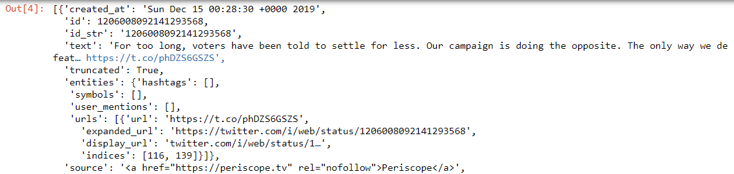
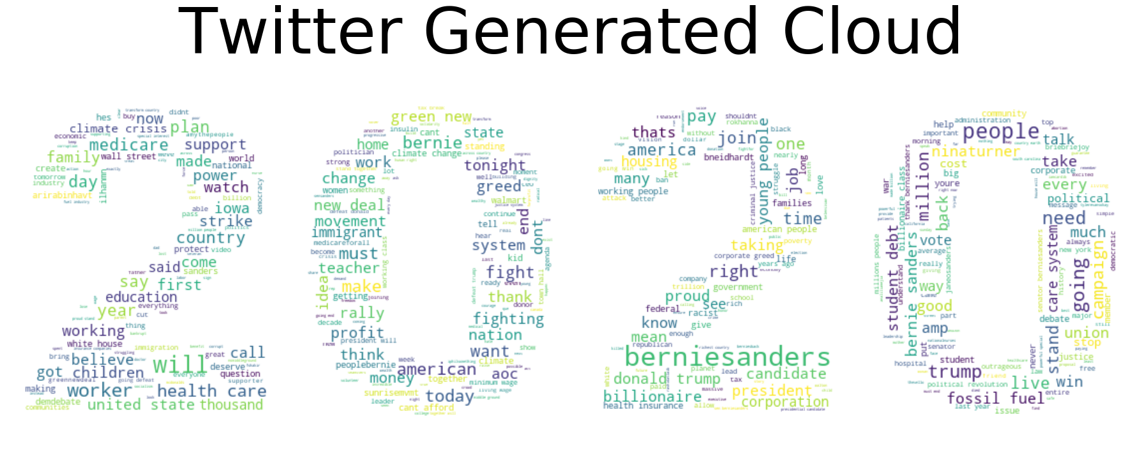
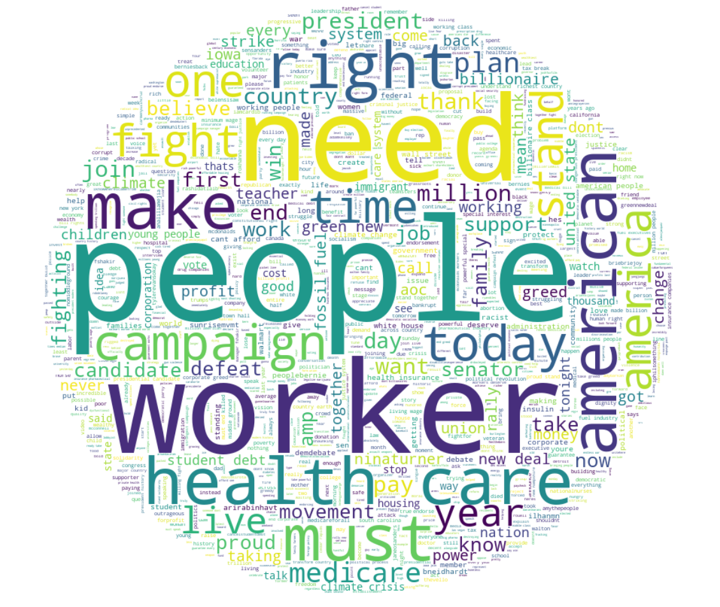
Data Preparation and Cleaning
First, I had to extract the relevant text from the JSON format returned by the twitter API
Then the text was converted to a list of strings and irrelevant words (stopwords) were removed. This list of stopwords had to be updated with each candidate to remove the words related to their own names, etc.
Finally the format of the word-could was also changed from a ‘2020’ mask to a round mask for better and more comprehensible visualization.

Slide 6
Research Question(s)
Can Social Media help general public understand the political (election) agenda of the candidates?
Are the political agendas reflected on the tweets of the Candidates?

Slide 7
Methods
This study will analyze the recent 3,200 tweets from each of the 4 major presidential candidates in the American Presidential election 2020 and crate a word-could of the most frequently used words to visualize / understand the priorities and the election agenda of the candidates. Since this is a text based data, fairly limited in quantity, and in widely varying topics/issues, sentiment analysis or similar Machine Learning study is less appropriate and simple word clouds are very effective to outline the general talking points.

Slide 8
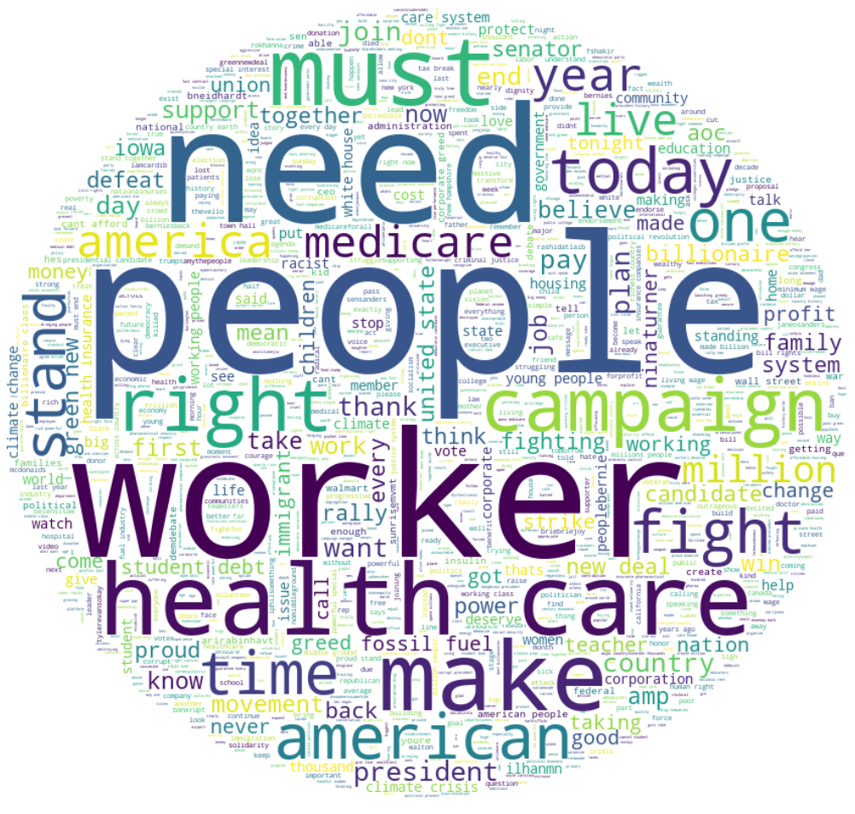
Findings 1 – Bernie Sanders
Words like people, worker, health care, american, etc. are most prominent indicating the candidates focus.
There are some words with little value addition, like must, need, one, make, etc.
Some of the words that form key agenda are included but not prominent like medicare, student debt, green new (deal), fossil fuel, climate crisis, etc.
While some key agenda are not prominent, the tweets give some idea on the election agenda.

Slide 9
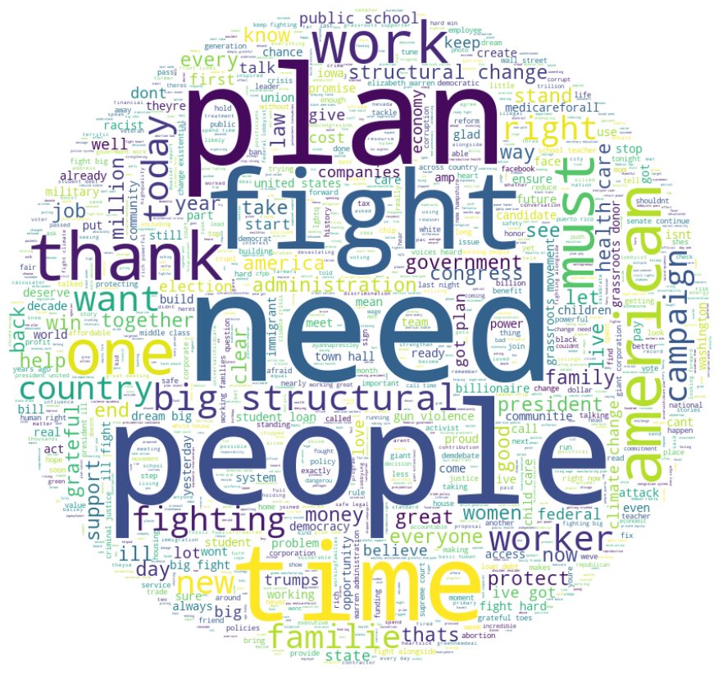
Findings 1 – Elizabeth Warren
Words like people, plan, work, american, etc. are most prominent indicating the candidates focus.
There are some words with little value addition, like must, need, one, thank, etc.
Some of the words that form key agenda are included but not prominent like public school, job, worker, black community, etc.
Overall, it is difficult to understand the priorities/agenda.

Slide 10
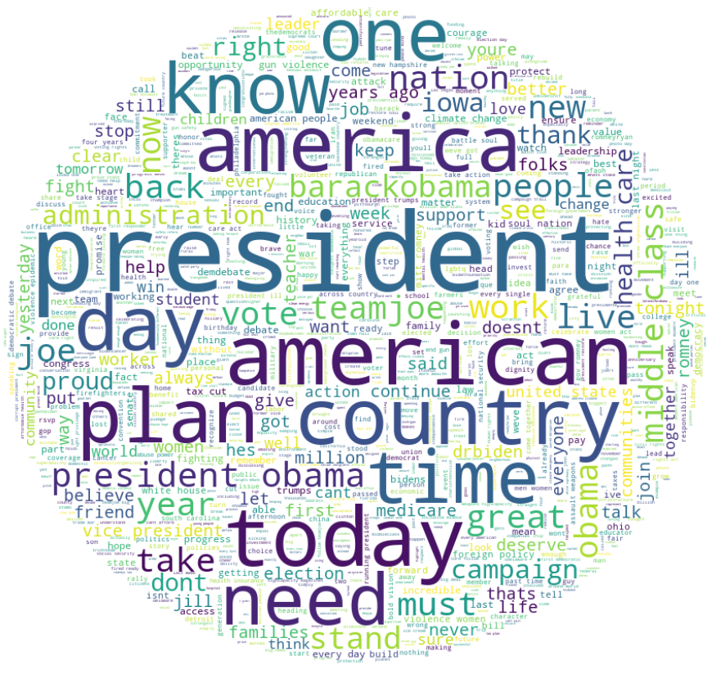
Findings 3 – Joe Biden
Words like american, country, middle class, etc. are most prominent suggesting some focus on the topics but difficult to identify
There are some words with little value addition on the agenda like know, need, one, president obama, obama etc.
Some of the words that form key agenda are included but not prominent like health care, tax cut, job, women, community, affordable care, climate change, etc.
It is not easy to understand priorities or agenda.

Slide 11
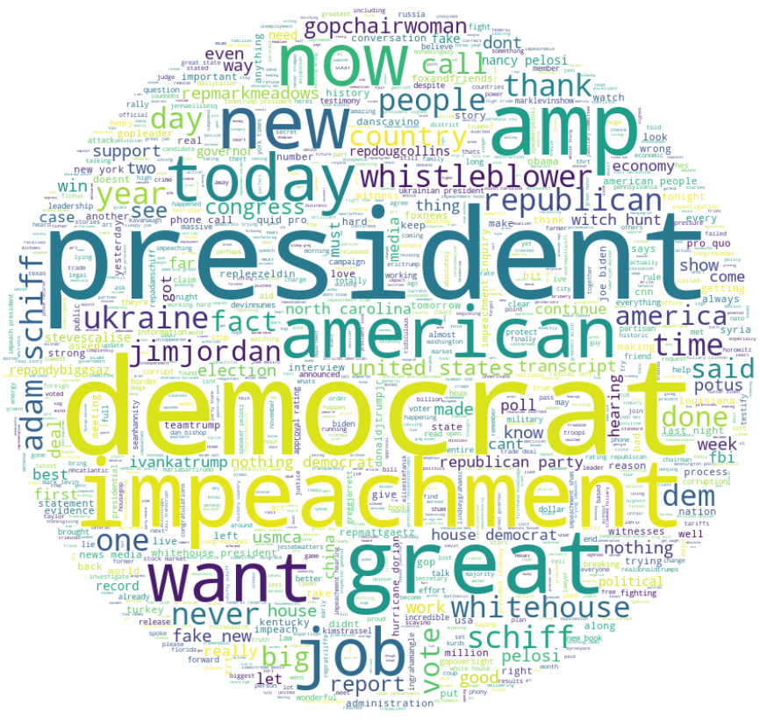
Findings 4 – Donald Trump
Being a sitting president, it is expected that the tweets may not be as agenda focused given priorities of current administration indiacted by words like democrat, impeachment, ukraine, whistleblower, job etc.
There are some words with little value addition, like great, new, now, want, etc.
Some of the words that form key agenda are included but not prominent like fake news, economy, military, china, turkey, media, etc.
Thus, the tweets are not well indicative of the key election agenda/priorities.

Slide 12
Limitations
The data source is ineherently limited by the number of tweets that can be accessed for free. Further, this study could be extended by analyzing texts from the speeches from rallies and campaigns leading up to the election.

Slide 13
Conclusions
It can be seen that not all candidates may be using social media (twitter) equally to deliver key messages and agenda leading to the election. For instance, it was relatively more apparent and easier to comprehend in case of Bernie Sanders, while the tweets from the current president seemed least focused on communicating the key agenda as he, understandably, is more focused on imminent issues related to his adminstration.
One thing that’s very apparent in all the candidates is that, while the key election agenda like health care, education, tax etc. may be mentioned, but they are not always focused highly in the tweets, and most of the tweets convey general messages/spontaneous reactions rather delivering strategic messages.
Thus, it can be suggested that depending on social media alone for foming political understanding or learning about key election agenda may not be adeqaute, at least not in months’ advance.

Slide 14
Acknowledgements
Some of the work done has been based on the following sources:
https://medium.com/@shsu14/introduction-to-data-science-custom-twitter-word-clouds-704ec5538f46
IBM Cognitive Class – Data Visualization

